Slide 1
Audio Fingerprinting
EECS 352: Machine Perception of Music & Audio

Slide 2
Credit
Most of the content was stolen… I mean borrowed from:
Meinard Müller and Joan Serrà, “Audio Content- Based Music Retrieval (tutorial),” 12th International Society for Music Information Retrieval, Miami, FL, USA, October 24-28, 2011
http://ismir2011.ismir.net/tutorials/2011_MuellerSerra_MusicRetrieval_Tutorial-ISMIR_handouts-2.pdf

Slide 3
Outline
Introduction
Context, literature, etc.
Shazam
Fingerprinting, matching, etc.
Philips
Fingerprinting, matching, etc.
Conclusion
Advantages, limitations, etc.

Slide 4
Problem
You are at home, in your car, in a café, etc.
You hear an audio signal (e.g., a song)
You want to quickly know more about it (e.g., title)
You have a smart device (e.g., a smartphone)

Slide 5
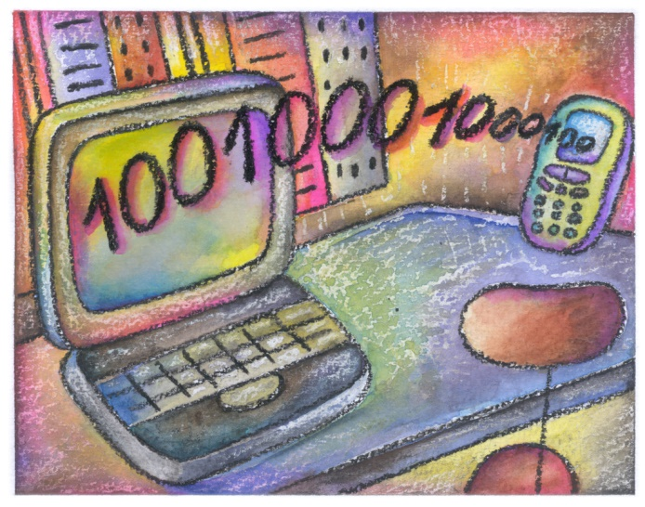
Solution
You use an audio identification system
You record an excerpt of the audio signal
It is compared against a database for a match
You get information about the audio signal

Slide 6
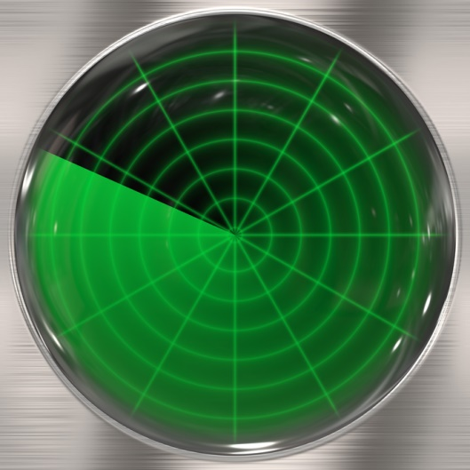
Principle
Audio identification works as follows:
Convert the audio signal into an audio fingerprint
Generate a database of known references
Match an unknown query against the database

Slide 7
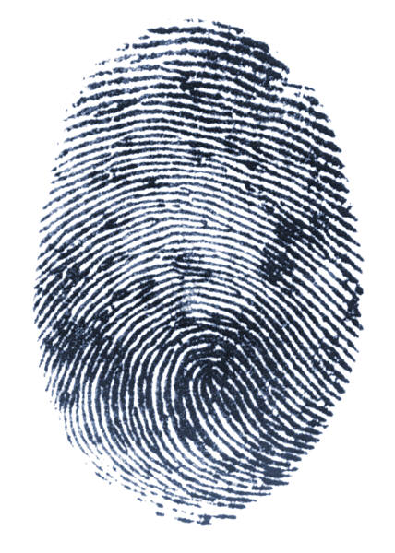
Requirements
Audio fingerprints have to be:
Compact (= small storage and fast search)
Discriminative (= less false positives)
Robust (= invariance to audio degradations)

Slide 8
Literature
Haitsma et al., 2002 (Philips)
Sign of energy differences in time and frequency
Burges et al., 2003 (Microsoft)
Two-level Principal Component Analysis (PCA)
Wang et al., 2003 (Shazam)
Pairs of time-frequency peaks from spectrogram
Baluja et al., 2007 (Google)
Sign of wavelets from spectrogram

Slide 9
Literature
Haitsma et al., 2002 (Philips)
Sign of energy differences in time and frequency
Burges et al., 2003 (Microsoft)
Two-level Principal Component Analysis (PCA)
Wang et al., 2003 (Shazam)
Pairs of time-frequency peaks from spectrogram
Baluja et al., 2007 (Google)
Sign of wavelets from spectrogram

Slide 10
Outline
Introduction
Context, literature, etc.
Shazam
Fingerprinting, matching, etc.
Philips
Fingerprinting, matching, etc.
Conclusion
Advantages, limitations, etc.

Slide 11
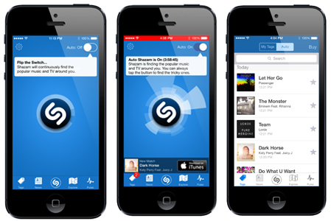
Shazam
Background
Based on the work of Avery Wang
Founded in 1999, commercialized in 2002
Database of more than 11 millions of songs
www.shazam.com

Slide 12
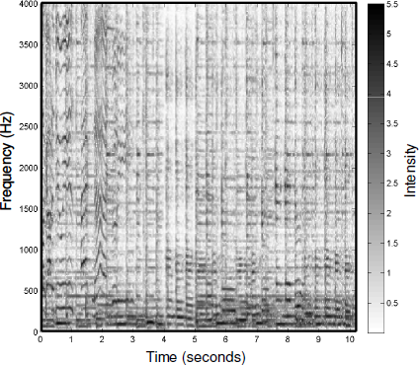
Fingerprinting
The audio signal (e.g., a song) is first transformed into a spectrogram
Spectrogram

Slide 13
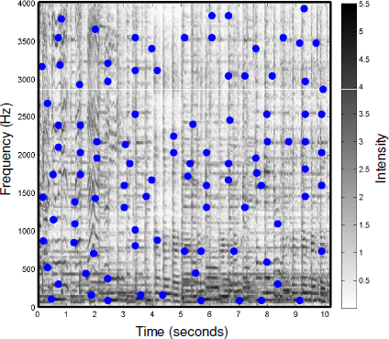
Fingerprinting
Peak locations in the spectrogram are identified given some criteria (e.g., density)
Spectrogram

Slide 14
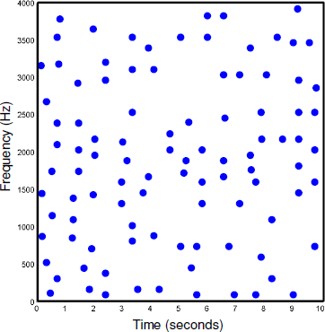
Fingerprinting
This leads to an audio fingerprint that is both compact and robust to audio degradations
Fingerprint

Slide 15
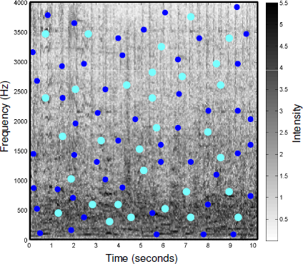
Fingerprinting
In the presence of noise or distortion, most peaks should survive as they have high energy
Spectrogram
Peaks of interest
Spurious peaks

Slide 16

Matching
A fingerprint is extracted from the query and compared to the fingerprints of the references
Fingerprint of a reference
Fingerprint of the query

Slide 17
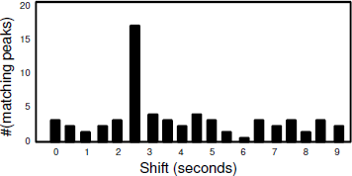
Matching
The query fingerprint is shifted along time against every reference fingerprint

Slide 18
Matching
The number of peaks that are matching is counted and saved for every possible shift

Slide 19
Matching
The number of peaks that are matching is counted and saved for every possible shift

Slide 20
Matching
The number of peaks that are matching is counted and saved for every possible shift

Slide 21
Matching
A high count indicates a match, and the corresponding reference is identified

Slide 22
Indexing
In practice, the fingerprints are encoded by using pairs of peaks to speed up the matching
Fingerprint

Slide 23
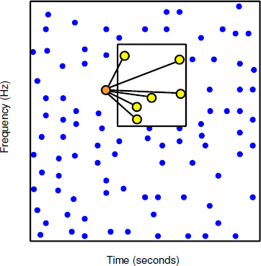
Indexing
For every peak, pairs of peaks are formed by choosing an anchor point and a target zone
Fingerprint
Anchor peak
Target peaks

Slide 24
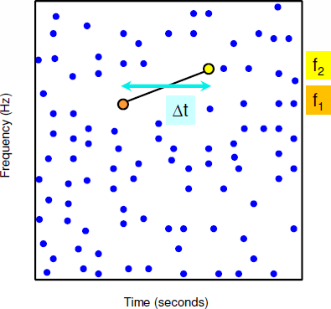

Indexing
For every pair of peaks, a hash is formed using two frequency values and a time difference
Fingerprint
Anchor peak
Target peaks
Hash =

Slide 25
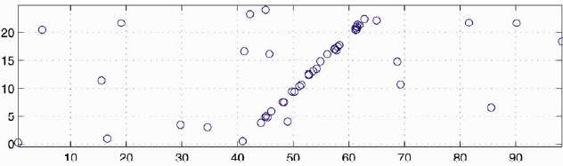
Indexing
Hashes from a query are compared to hashes from every reference, given their offset times
Matching hashes between query and reference
Time for query
Time for reference
Isolated match between
a query hash and
a reference hash
Cluster of matches between
the query hashes and
the reference hashes

Slide 26
Outline
Introduction
Context, literature, etc.
Shazam
Fingerprinting, matching, etc.
Philips
Fingerprinting, matching, etc.
Conclusion
Advantages, limitations, etc.

Slide 27
Philips
Background
Based on the work of Jaap Haitsma and Ton Kalker
Technology sold to Gracenote, Inc. in 2005
Not (really) commercialized (yet)
www.gracenote.com

Slide 28
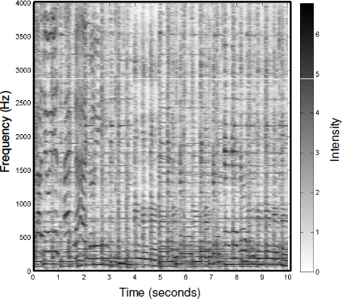
Fingerprinting
The audio signal (e.g., a song) is first transformed into a spectrogram
Spectrogram

Slide 29
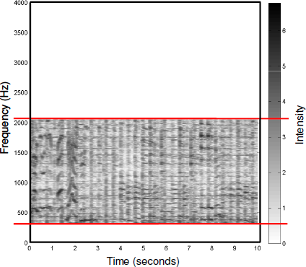
Fingerprinting
A perceptually relevant frequency range is selected from the spectrogram (300-2000 Hz)
Spectrogram (cropped)
300-2000 Hz

Slide 30
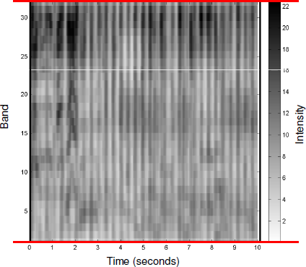
Fingerprinting
33 logarithmically-spaced frequency bands are extracted from that frequency range
Spectrogram (log-scaled)
33 log-spaced
frequency bands

Slide 31
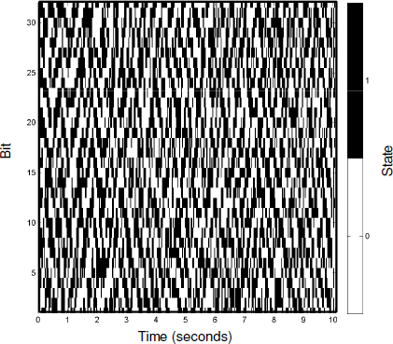
Fingerprinting
The sign of the energy difference together along time and frequency is computed
Spectrogram (binarized)
frequency
time
First, difference in time;
then, difference in frequency.
If result higher than 0, bin is 1;
otherwise, bin is 0.

Slide 32
Fingerprinting
This leads to a sub-fingerprint of 32 bits for every time frame in the spectrogram
Sub-fingerprints
Sub-fingerprint
of 32 bits

Slide 33
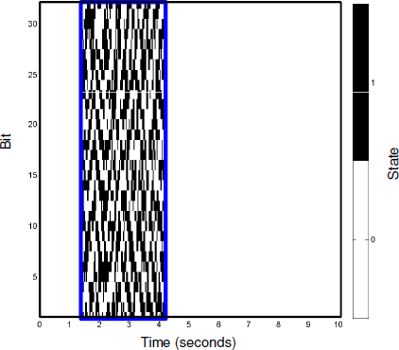
Fingerprinting
A fingerprint-block is derived by grouping 256 successive sub-fingerprints (= 3 seconds)
Fingerprint-block

Slide 34
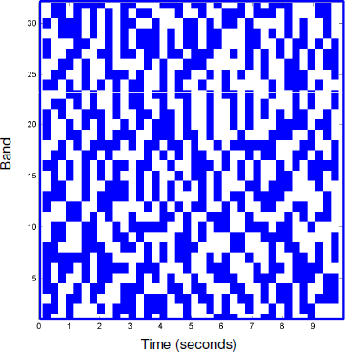

Matching
A fingerprint is extracted from the query and compared to the fingerprints of the references
Fingerprint of a reference
Fingerprint of the query

Slide 35
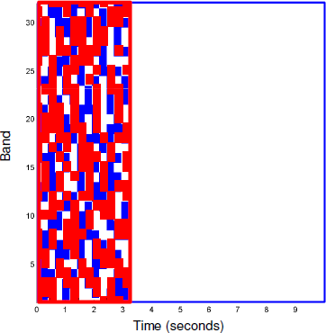
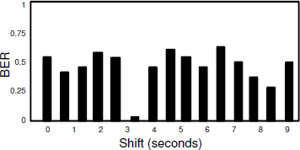
Matching
The query fingerprint-block is shifted along time against every reference fingerprint-block

Slide 36
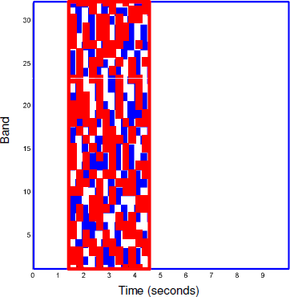
Matching
The Bit Error Rate (BER) (% non-matching bits) is computed and saved for every possible shift

Slide 37
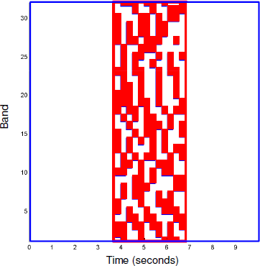
Matching
The Bit Error Rate (BER) (% non-matching bits) is computed and saved for every possible shift

Slide 38
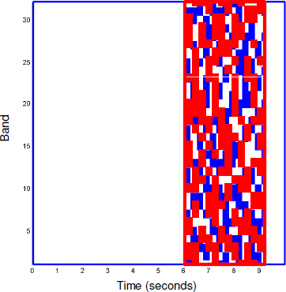
Matching
The Bit Error Rate (BER) (% non-matching bits) is computed and saved for every possible shift

Slide 39
Matching
A low BER indicates a match, and the corresponding reference is identified

Slide 40
Indexing
In practice sub-fingerprints are encoded using hashing to speed up the matching
Fingerprint of a reference
Fingerprint of the query

Slide 41
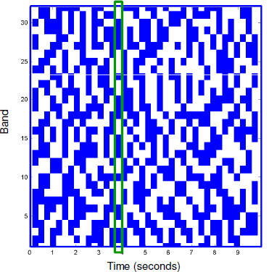
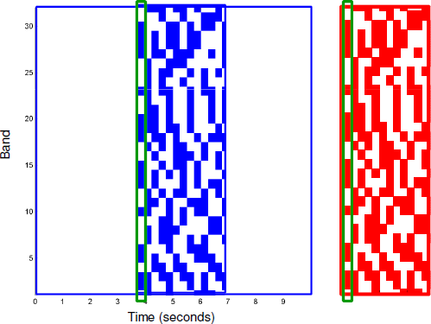
Indexing
Exact sub-fingerprint matches are used to identify candidate reference fingerprint-blocks
Fingerprint-block of a reference
Fingerprint-block of the query

Slide 42
Indexing
BER is computed only for the candidate reference fingerprint-blocks
Fingerprint-block of a reference
Fingerprint-block of the query

Slide 43
Indexing
A match is identified when BER falls below a certain threshold

Slide 44
Outline
Introduction
Context, literature, etc.
Shazam
Fingerprinting, matching, etc.
Philips
Fingerprinting, matching, etc.
Conclusion
Advantages, limitations, etc.

Slide 45

Advantages
Audio identification systems
Robust to distortion and noise
Short queries (3-10 seconds)
Fast matching (3-10 seconds)

Slide 46

Limitations
Needs exact same rendition!
No live version (different key or tempo)
No cover version (different instruments)
No hummed version (single melody)

Slide 47
Solutions
Fingerprints robust to key or tempo deviations
Log-frequency spectrogram for pitch shifting
Fingerprint invariant to time-scaling
Etc.

Slide 48
Solutions
Cover identification
Chromagram to handle key/instrument variations
Sequence alignment to handle tempo variations
Etc.

Slide 49
Solutions
Query-by-humming
Relative pitch intervals to handle key deviations
Relative length ratios to handle tempo deviations
Etc.

Slide 50
References
Shumeet Baluja and Michele Covell, “Audio Fingerprinting: Combining Computer Vision & Data Stream Processing,” 32nd International Conference on Acoustics, Speech and Signal Processing, Honolulu, HI, USA, April 15-20 2007, pp. II–213 – II–216.
Christopher J. C. Burges, John C. Platt, and Soumya Jana, “Distortion Discriminant Analysis for Audio Fingerprinting,” IEEE Transactions on Audio, Speech, and Language Processing, vol. 11, no. 3, pp. 165–174, May 2003.
Pedro Cano, Eloi Batlle, Ton Kalker, and Jaap Haitsma, “A Review of Audio Fingerprinting,” Journal of VLSI Signal Processing Systems, vol. 41, no. 3, pp. 271–284, November 2005.
Peter Grosche, Meinard Müller, and Joan Serrà, “Audio Content-based Music Retrieval,” Multimodal Music Processing, Meinard Müller, Masataka Goto, and Markus Schedl, Eds, vol. 3 of Dagstuhl Follow-Ups, chapter 9, pp. 157-174. Dagstuhl Publishing, Wadern, Germany, April 2012.
Jaap Haitsma and Ton Kalker, “A Highly Robust Audio Fingerprinting System,” 3rd International Conference on Music Information Retrieval, Paris, France, October 13-17 2002, pp. 107–115.
Avery Li-Chun Wang, “An Industrial-strength Audio Search Algorithm,” 4th International Conference on Music Information Retrieval, Baltimore, MD, USA, October 26-30 2003, pp. 7–13.

